Slide 1
Life Expectancy Report
Bin Xu, Di Kang, Jiahua Zhang, Yiwei Zhang

Slide 2
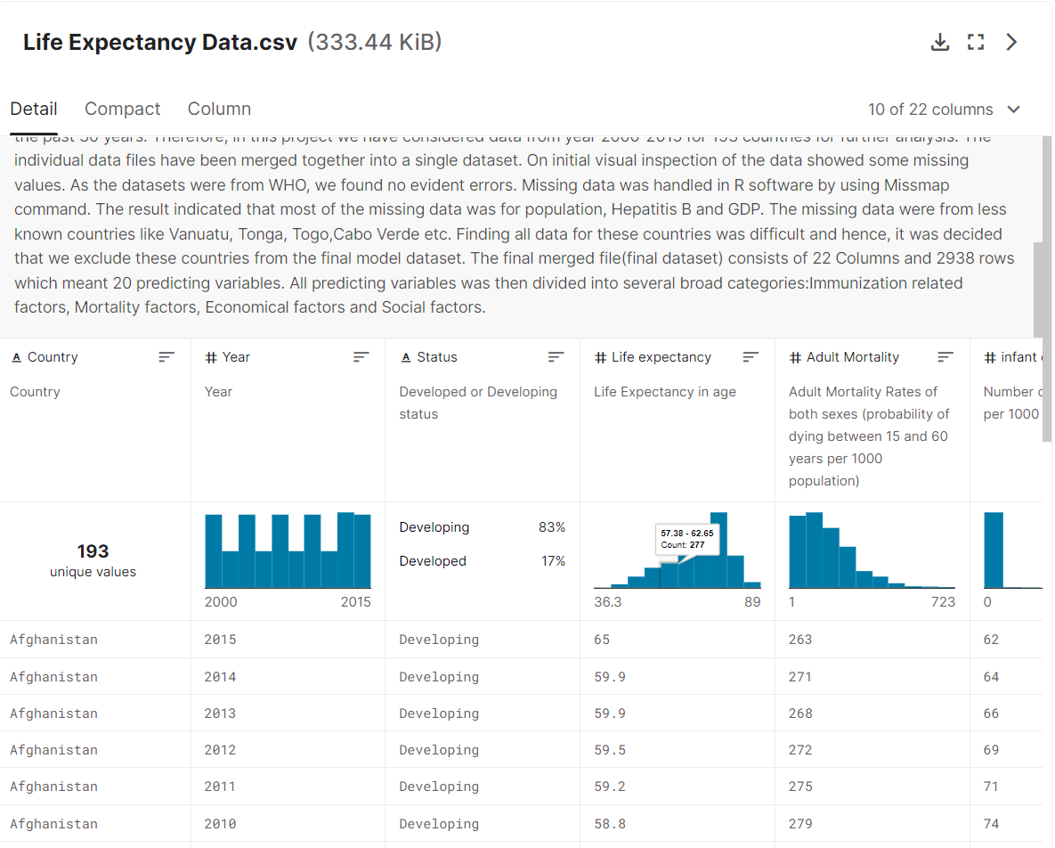
Data from Kaggle

Slide 3
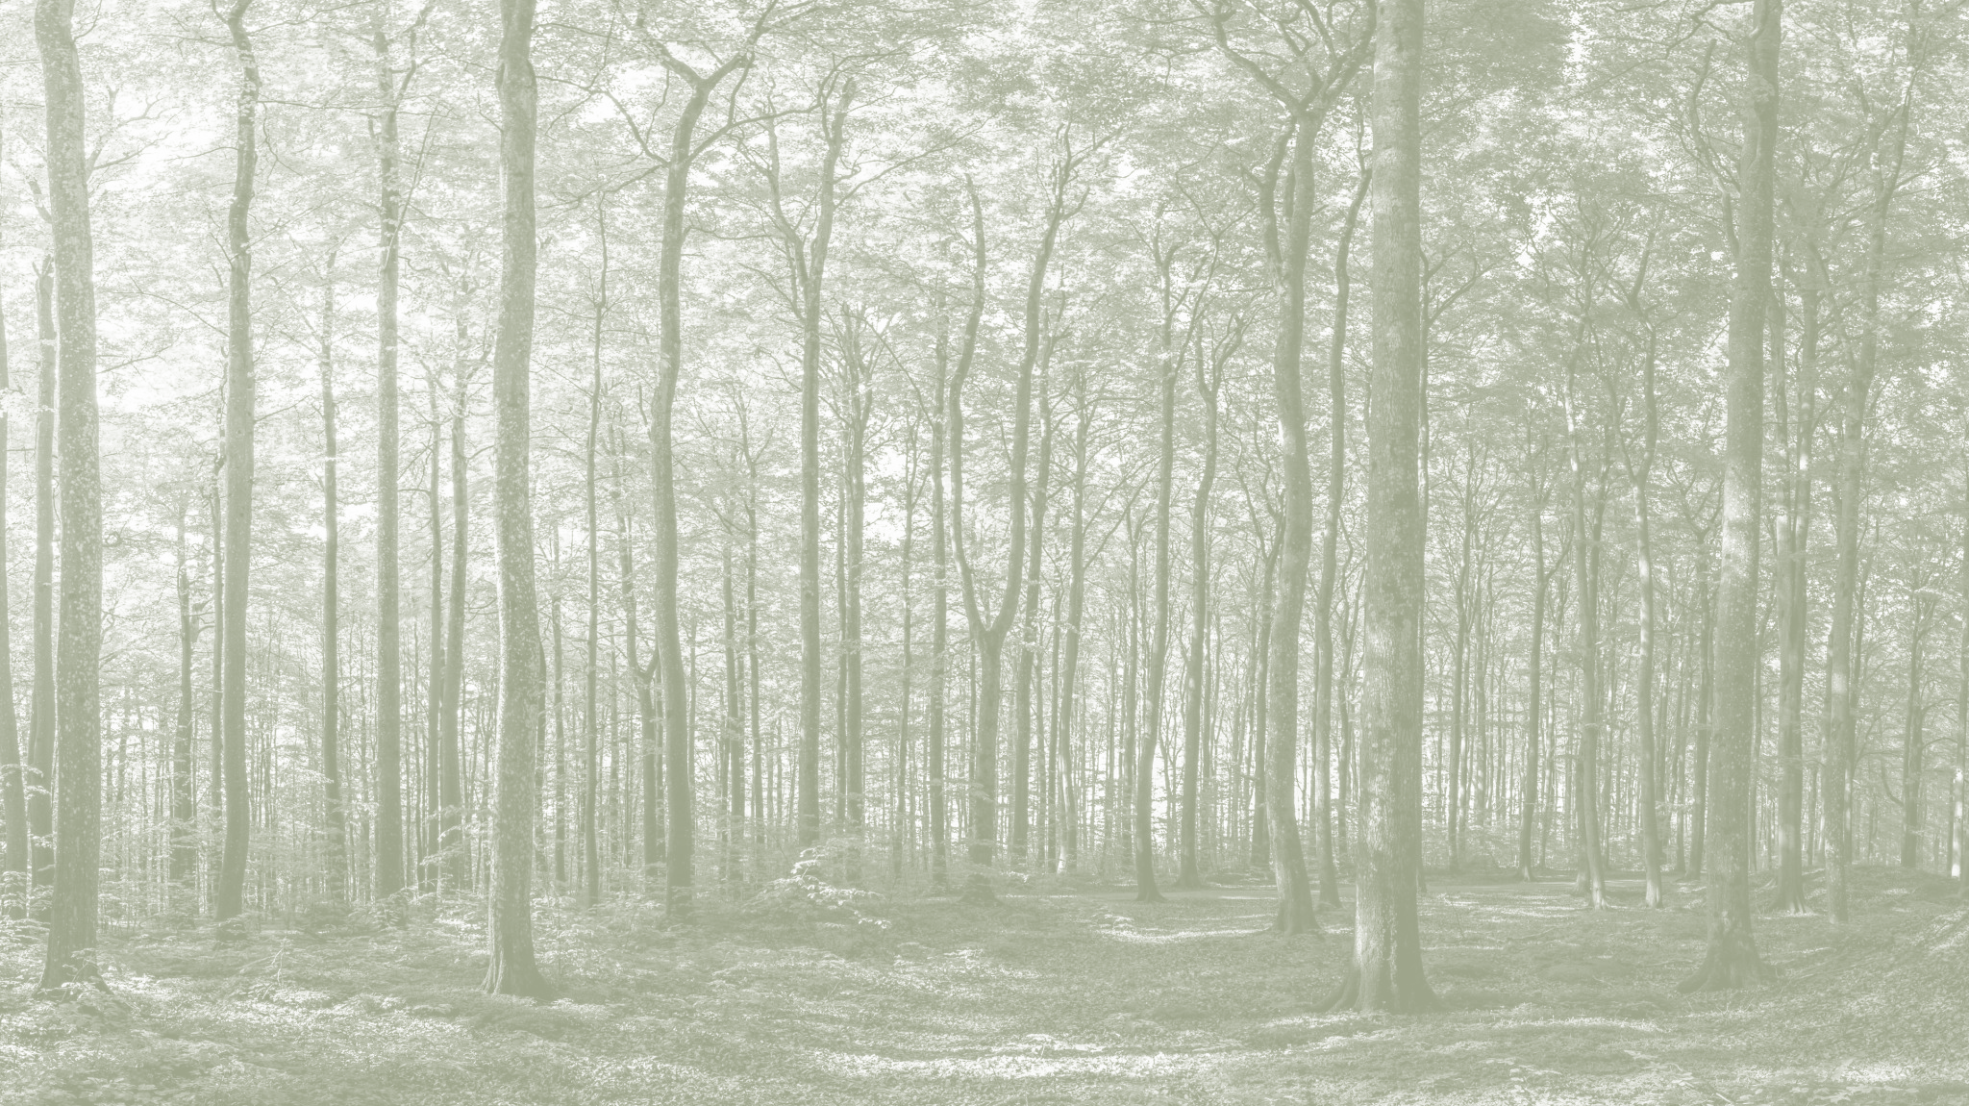
Approach
A random forest regressor trained on the life expectancy dataset provided via Kaggle
We combine the low bias and high variance trait of decision trees, merge a “forest” of trees to arrive at a more desired outcome.
Through visualizing each individual decision tree, we can somewhat reason why the model decided on the decision that was outputted.
Elevate each individual parameter by a percentage and seeing how much that would impact the life expectancy prediction outcome.
Notes:
Nonlinear:
10 dollars in a needy family
1 million for a billionaire

Slide 4
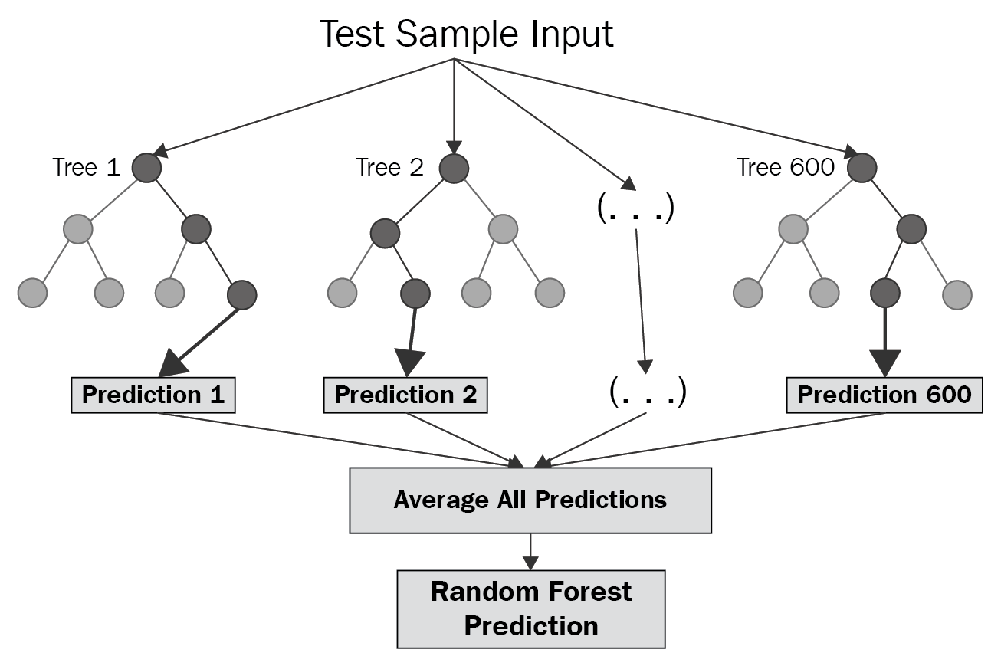
Random Forest

Slide 5
Random Forest regression advantage:
1.prefer for nonlinear or complex relationships between elements and labels.
2.It is not sensitive to the noise of training concentration

Slide 6
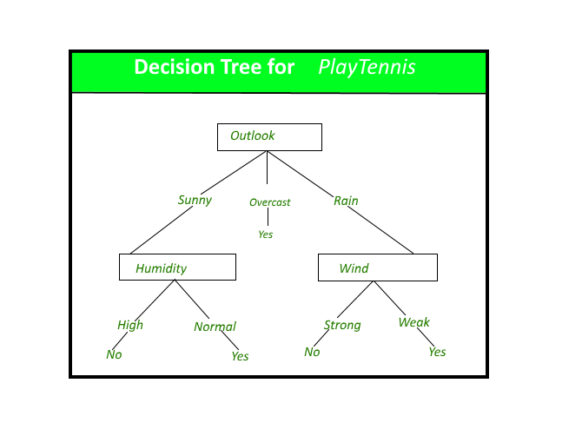
Decision Tree

Slide 7
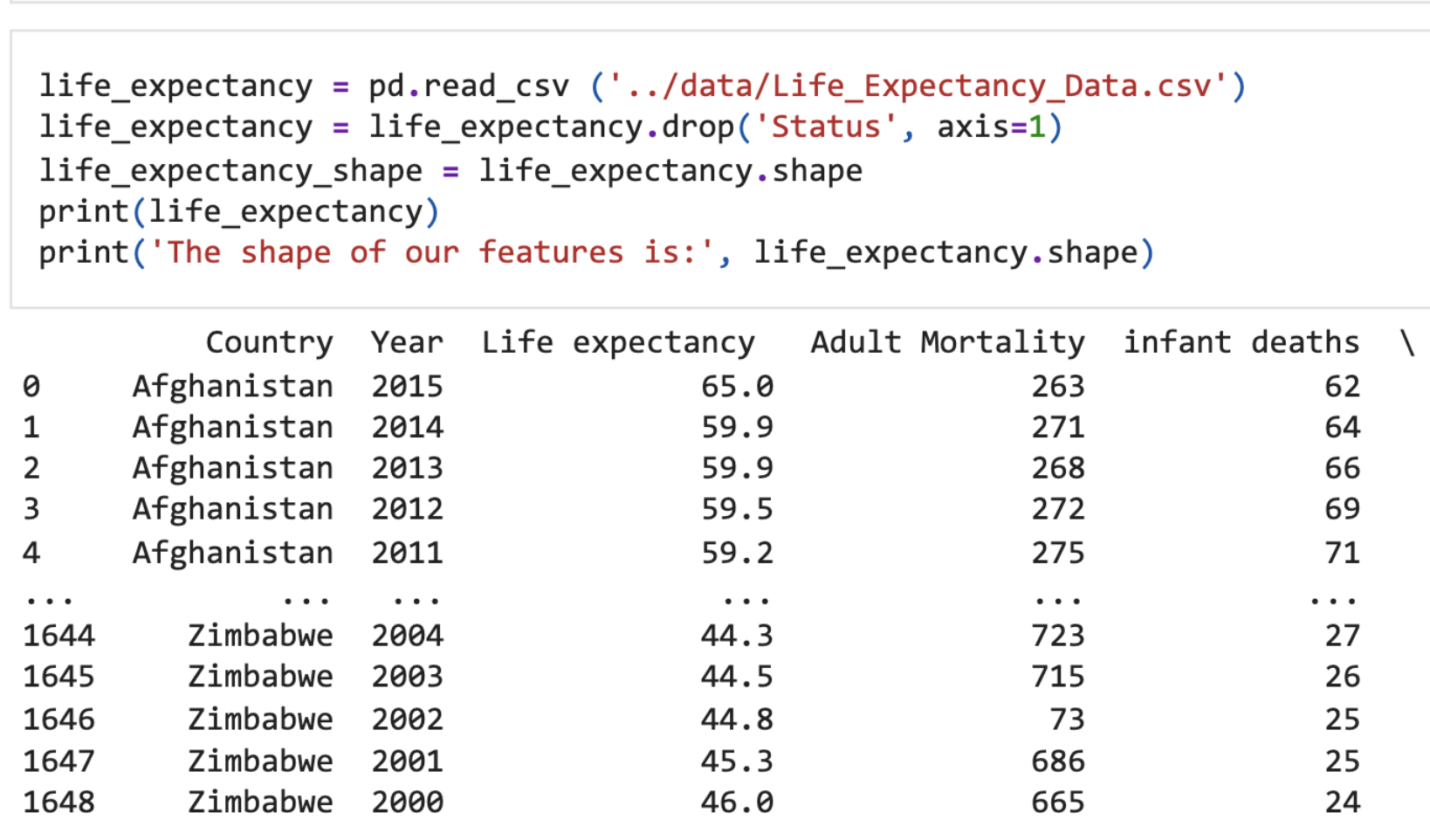
Processing Data

Slide 8
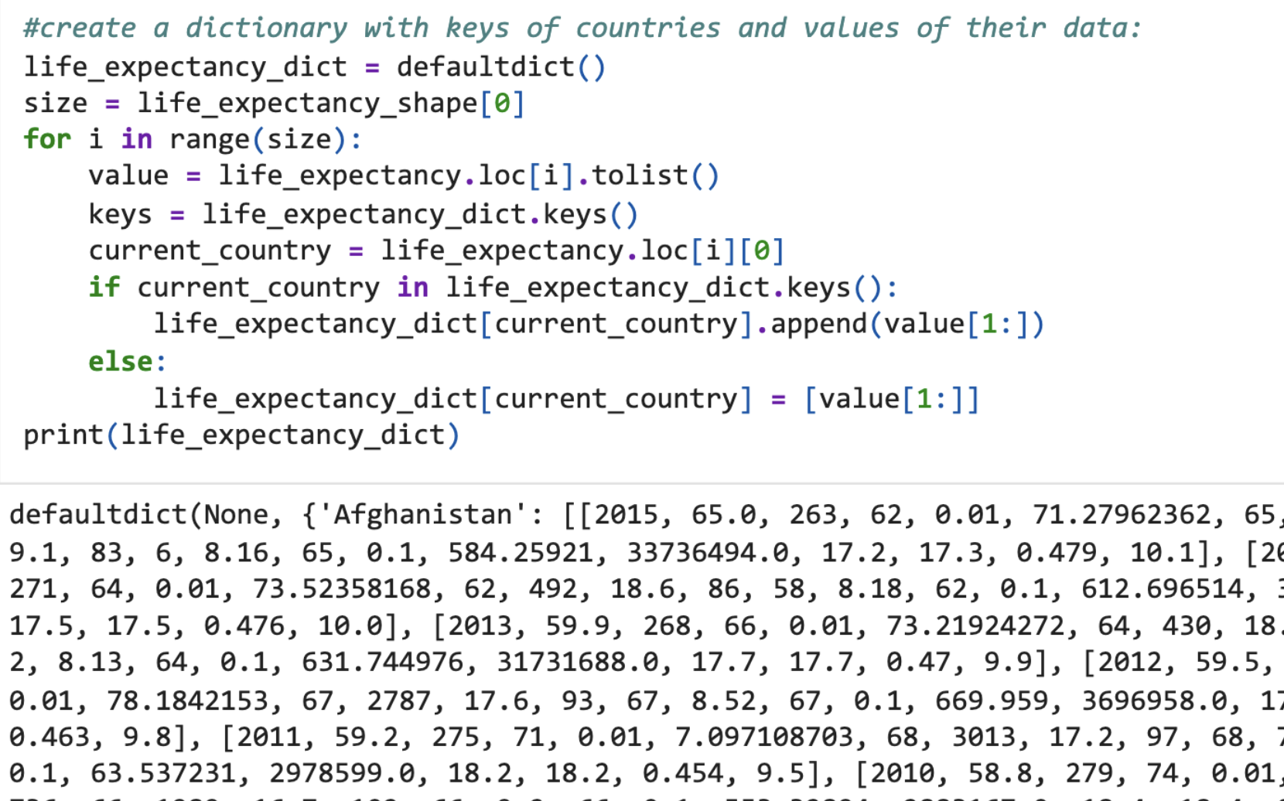
create a map to store the data, set country as key, and related data as value

Slide 9
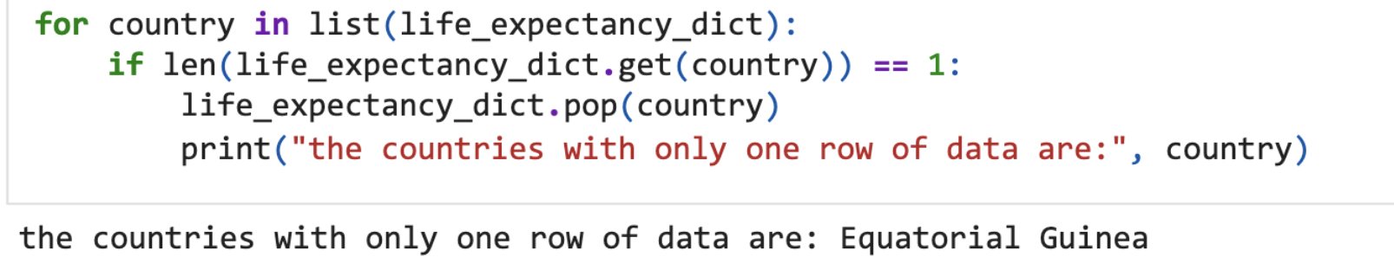
delete the exception data, we find there are two countries with only one row

Slide 10
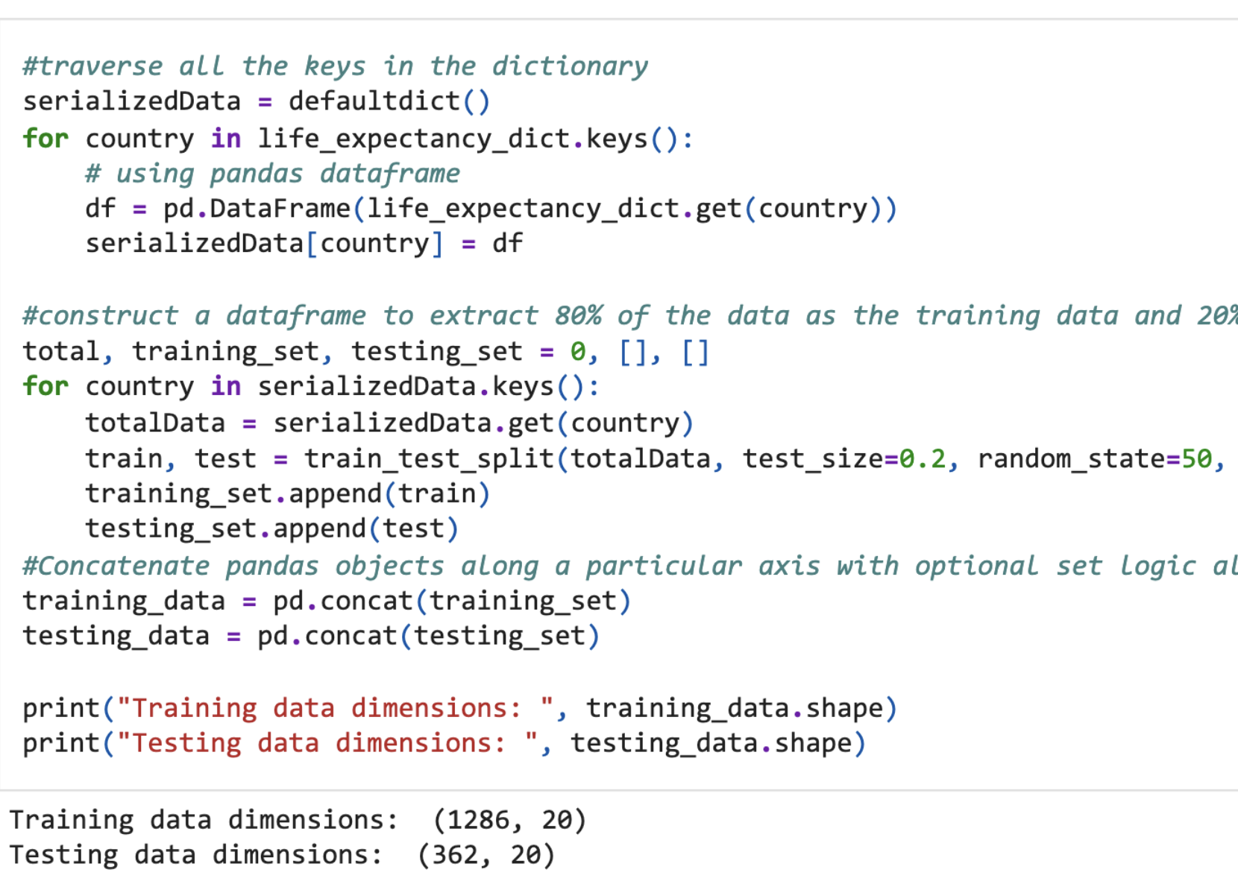
Set up test set and training set, 80% for testing, 20% for trainning

Slide 11
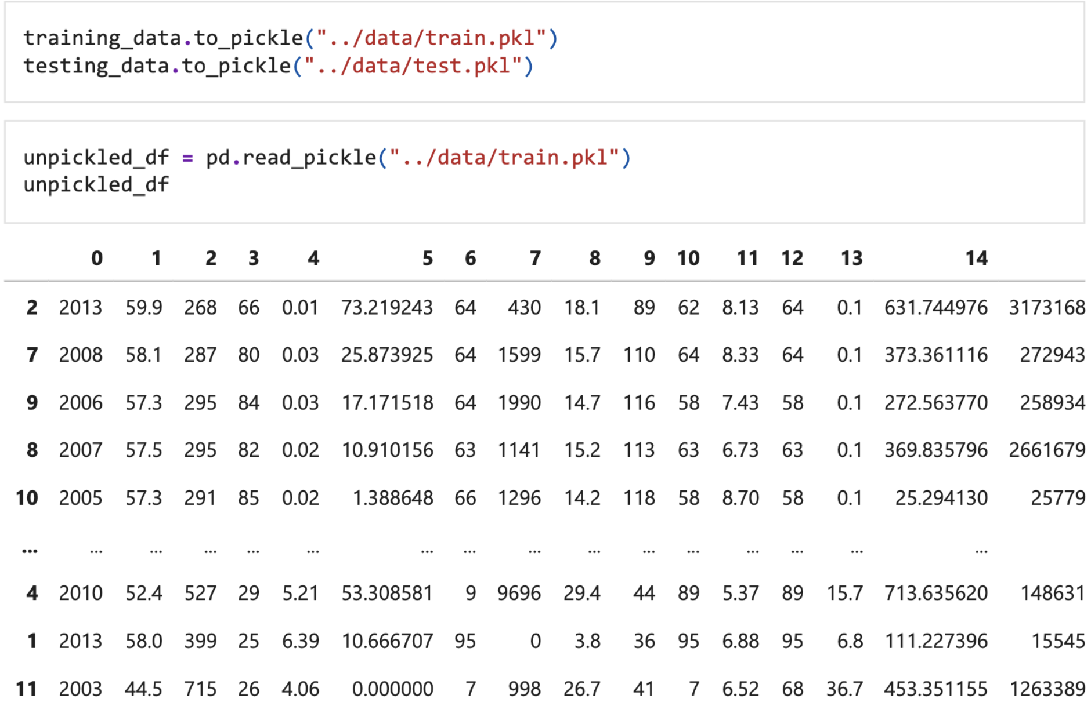
we transfer the filtered training and testing data to pickle file, it is a way to serialize then data

Slide 12
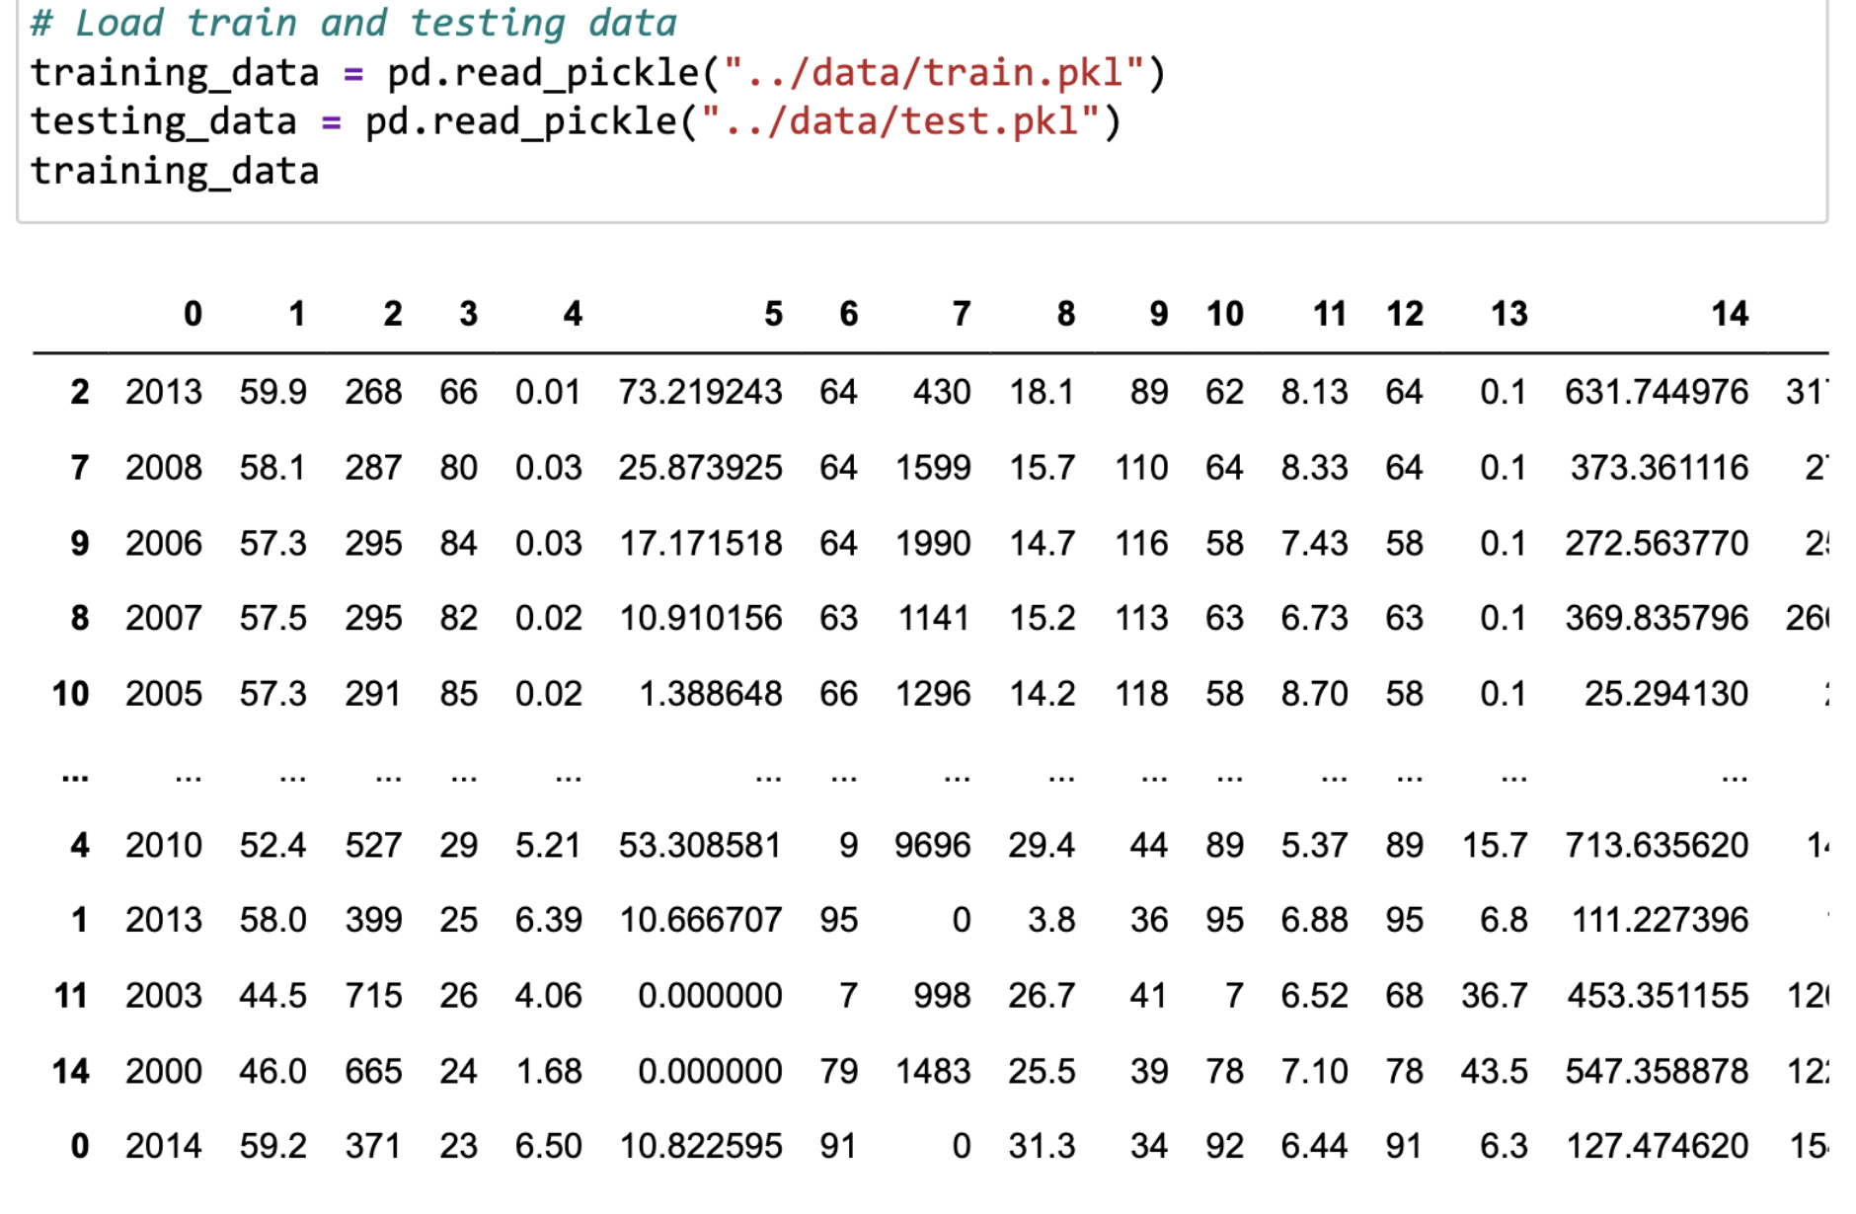

Slide 13
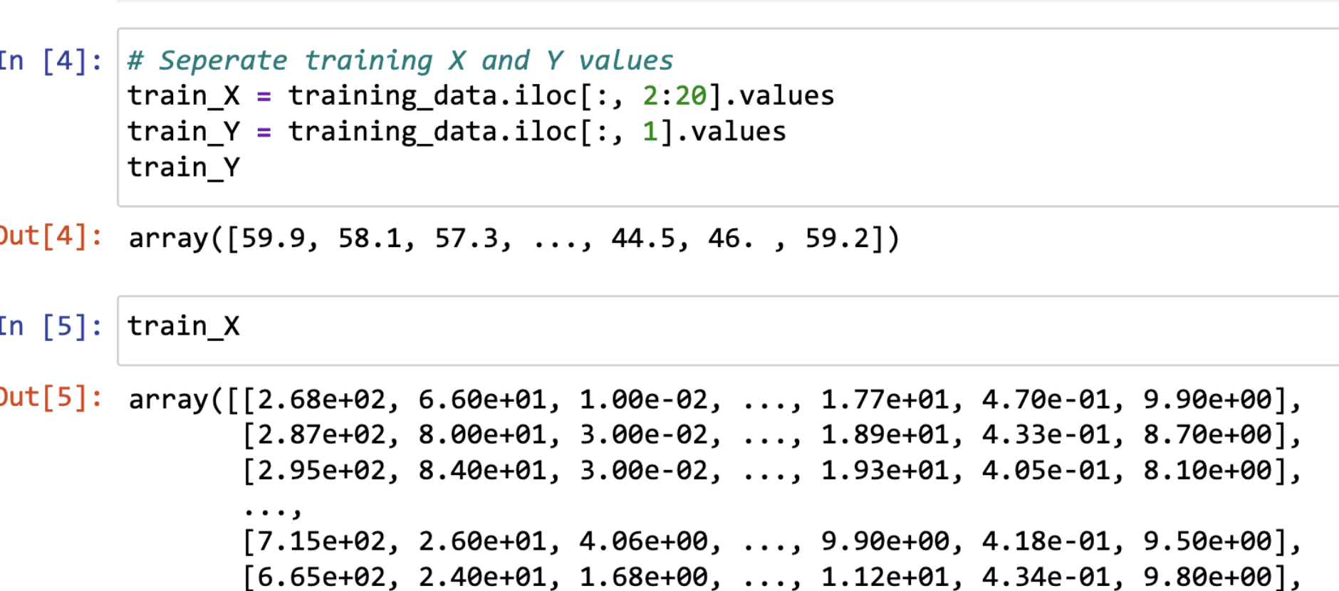
set the training y and x

Slide 14
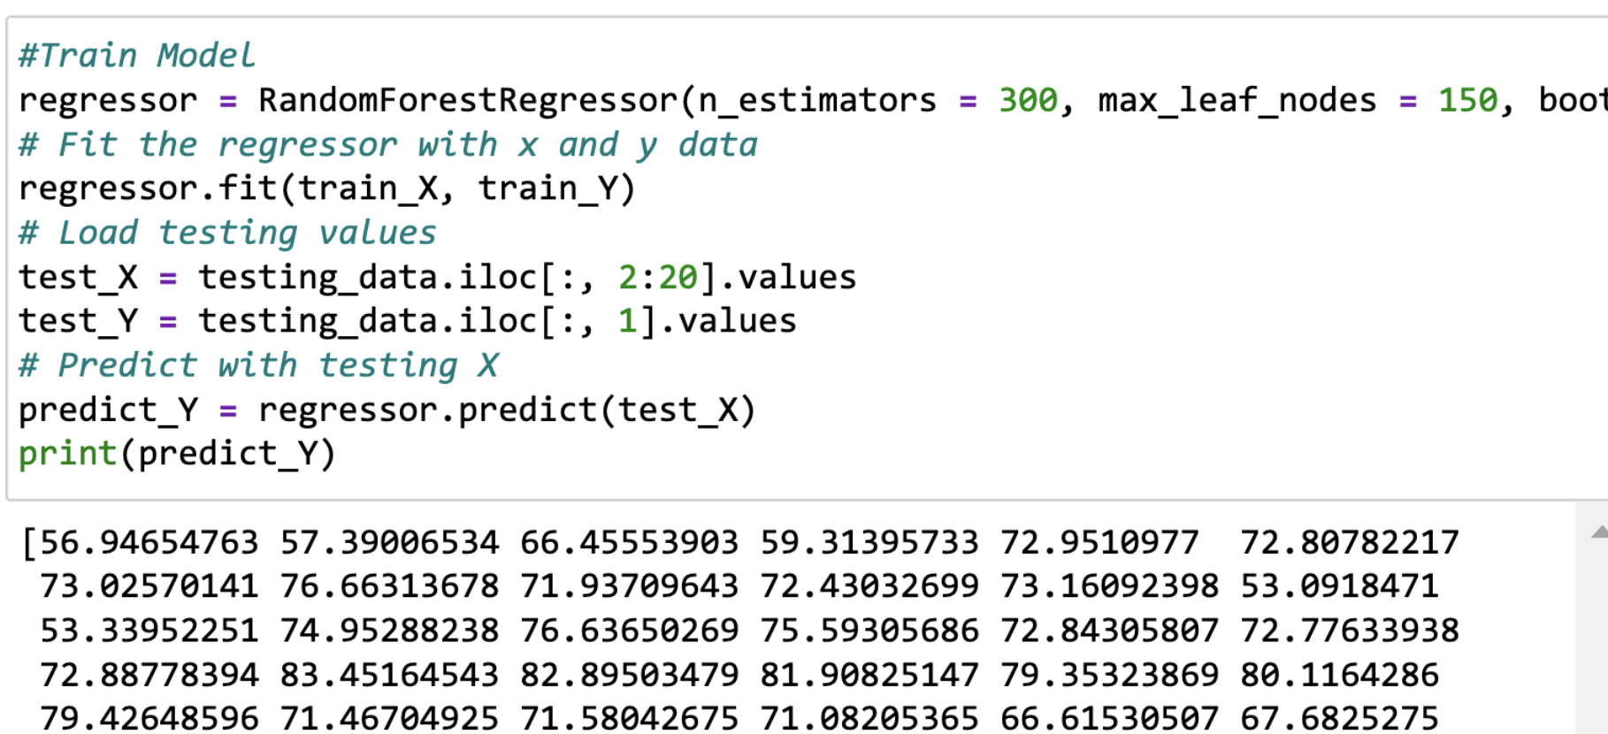
using model to train data

Slide 15
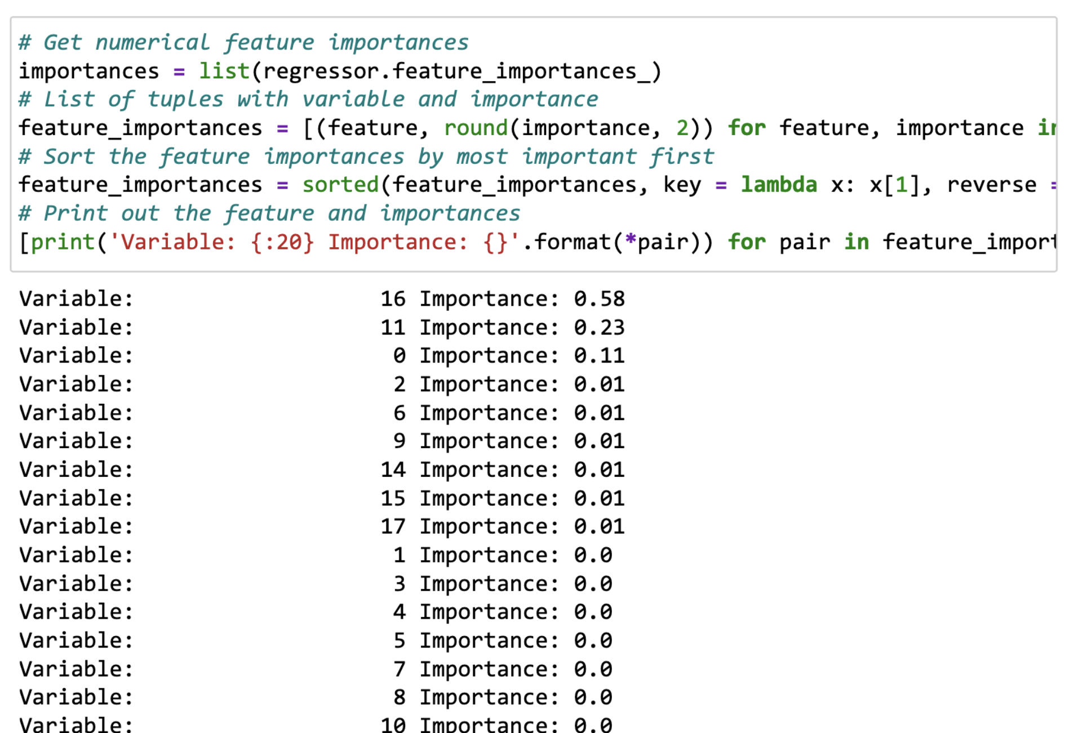
we calculate the importance of every feature:16 : thinness 1-19 years, 11 : Total expenditure, 0： Adult Mortality

Slide 16
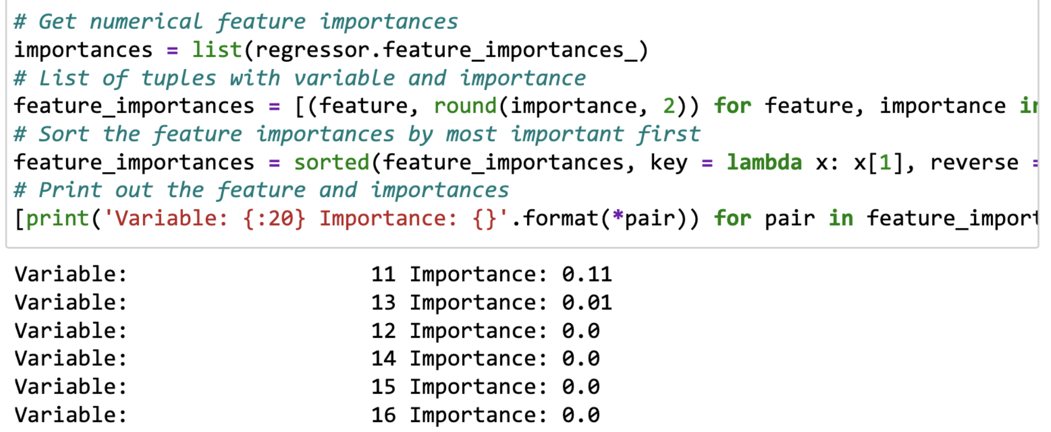
calculate the importance of updating testing data

Slide 17
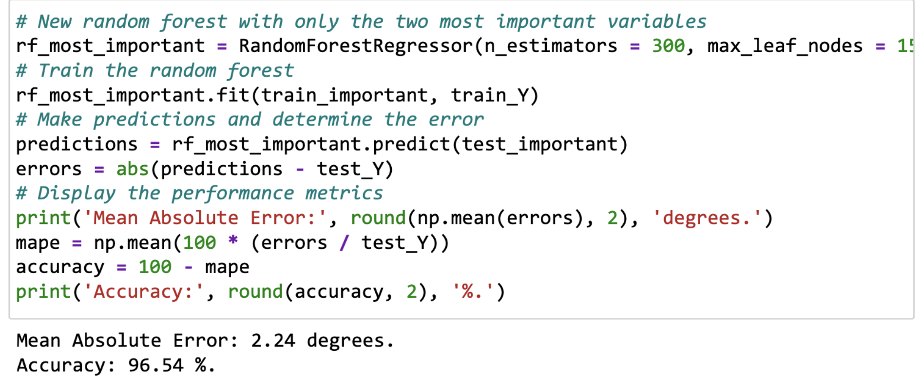

Slide 18
Results
Average difference on testing set: 0.7%
Average of (abs(predicted_y - actual_y) / actual_y)
Coefficient of determination R² (forest score): 0.95
Better accuracy the closer it is to 1
R² = (1 - u/v)
u defined as the residual sum of squares ((y_true - y_pred) ** 2).sum()
v defined as the total sum of squares ((y_true - y_true.mean()) ** 2).sum()
Notes:
Take the average loss of the regressor and yield a pretty good answer.

Slide 19
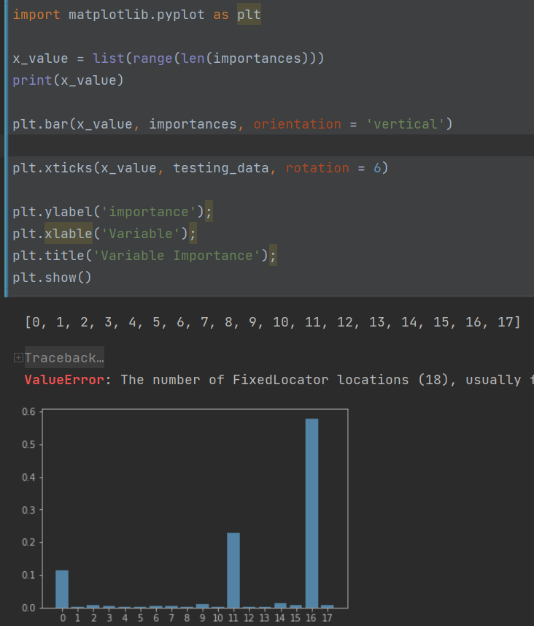
Results
most important features which influence the world:
0: Adult Mortality
11: Total expenditure
16: Thinness (under 19 years old)
Notes:
1%,10%,50%,100%增加相对比

Slide 20
Thanks you

